Slide 1
Human Sex Trafficking
And the rise of globalization

Slide 2
Introduction
$7 Billion dollar annual revenue
Increased Globalization
Increasing levels of trafficking
Traditionally Low Priority

Slide 3
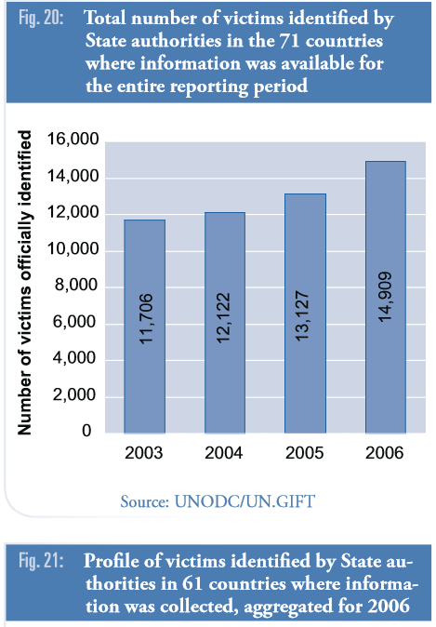
Growth

Slide 4
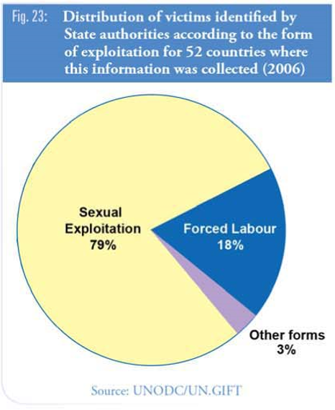
Trafficking

Slide 5
What Trafficking Is Not
Smuggling
Prostitution

Slide 6
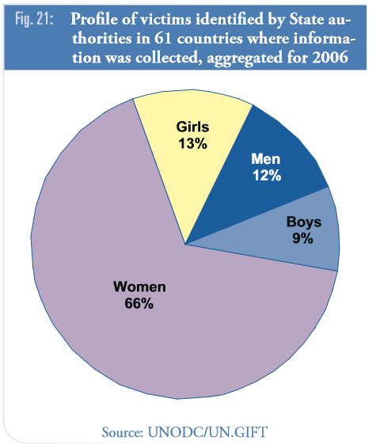
Largely Gendered Crime
Feminization of Poverty
Economic Instability
Gender Inequality
Social dislocation

Slide 7
Profile of traffickers
Lucrative Business
Savvy
Modern
International/Global reach

Slide 8
Policy Positions 20th Century
International Agreement for the Suppression of White Slave Traffic (1904)
Convention on the Suppression of Women of Full Age (1949)
The Convention on the Elimination of all Forms of Discrimination Against Women (1981)
1980’s Arrest and Deport

Slide 9
Policy Change United States and European Union
Jail the Offender
Strong on Enforcement Mechanisms
Weak on victim protections
United States TVPA

Slide 10
Global Alliance Against Traffic In Women
Protect the Victim
Weak On Organized Crime

Slide 11
Controversies
Highly politicized issue
Unclear data
Neo-abolitionists
Neo-regulationists

Slide 12
Conclusions
Address Factors of Migration and Immigration
Target Organized Crime
Protect Victims

